Slide 1


CENTRE OF EXCELLENCE (COE)
VERSION CONTROL WITH GIT
Dr.Y.Madhulika, Associate Professor

Slide 2
AGENDA
1
Introduction to git
2
Git versus GitHub
3
Git Features
4
Git Benefits
5
Add and Commit Operation
6
ADD, COMMIT, PUSH, PULL, FETCH, MERGE Operations
7
Branching and Merging
8
Home Task

Slide 3
INTRODUCTION TO GIT
Git is the most popular Version Control System nowadays because it is an open-source software which is easy to handle and perform work on various projects.
Git allows a team of people to work together, all are using the same files. And it helps the team cope up with the confusion that tends to happen when multiple people are editing the same files.
Git provides each developer a local copy of the entire development history, and changes are copied from one such repository to another.

Slide 4


GIT
Git is a free and open source distributed version control system designed to handle everything from small to very large projects with speed and efficiency.

Slide 5
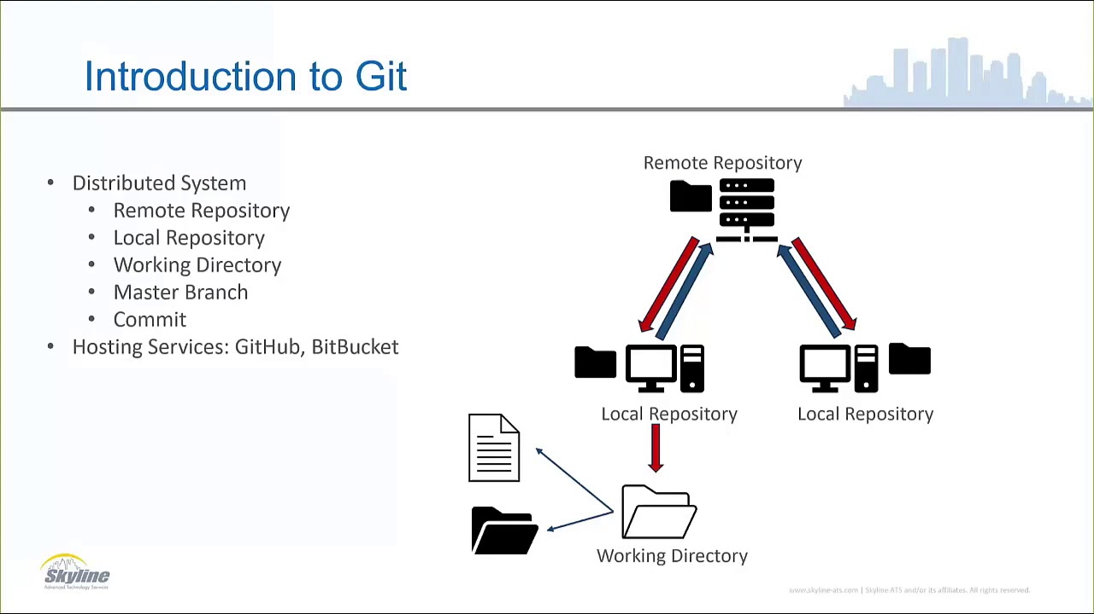
INTRODUCTION TO GIT

Slide 6
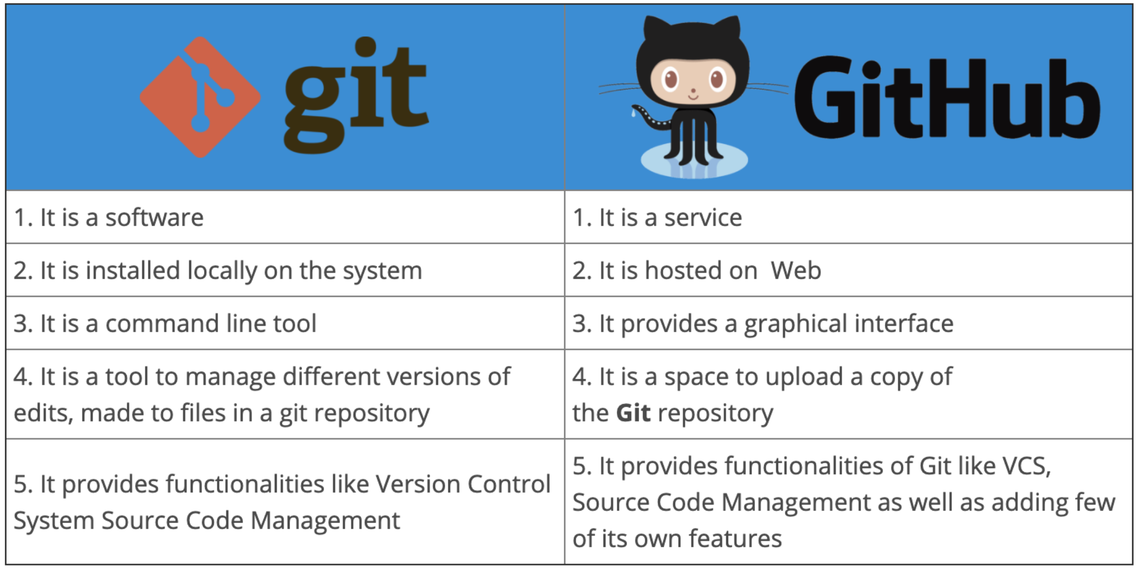
Git Vs GitHub

Slide 7
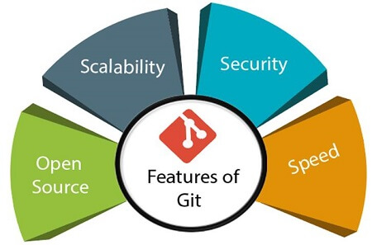
GIT FEATURES

Slide 8
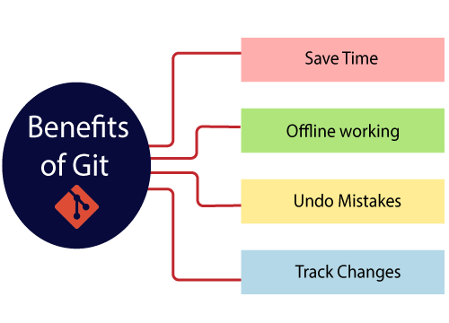
GIT BENEFITS

Slide 9
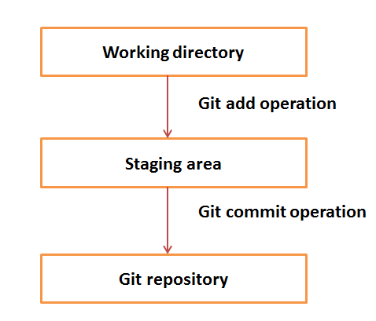
ADD and COMMIT Operation

Slide 10
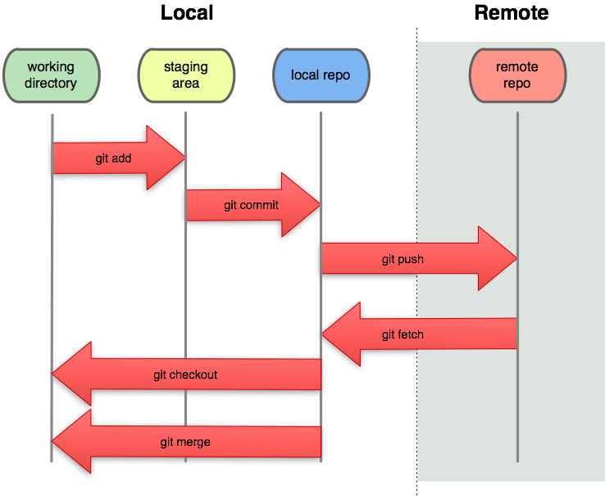
ADD, COMMIT, PUSH, FETCH, MERGE Operations

Slide 11

GIT BRANCHING

Slide 12
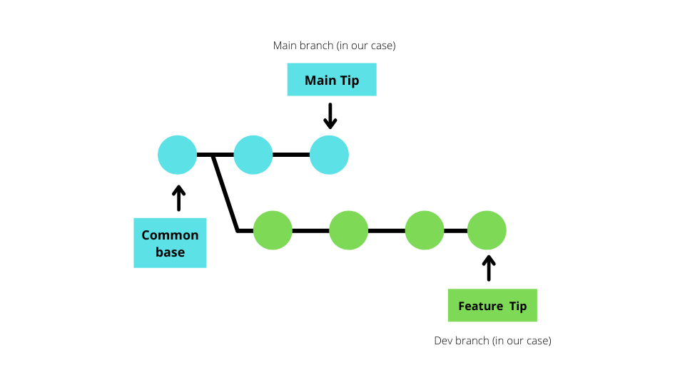
GIT BRANCHING - EXAMPLE

Slide 13
GIT MERGING

Slide 14
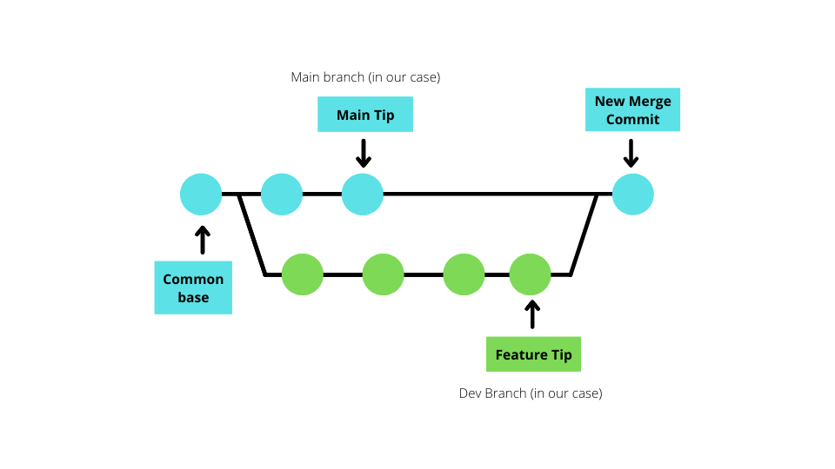
GIT MERGING - EXAMPLE

Slide 15
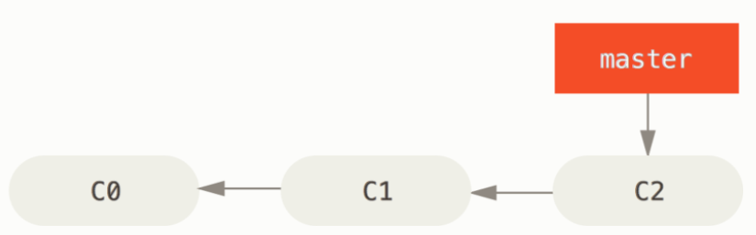
STEP 1

Slide 16
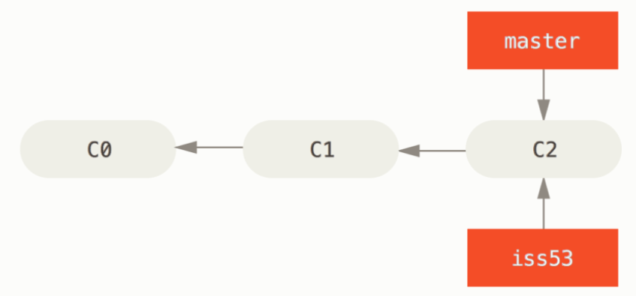
STEP 2

Slide 17
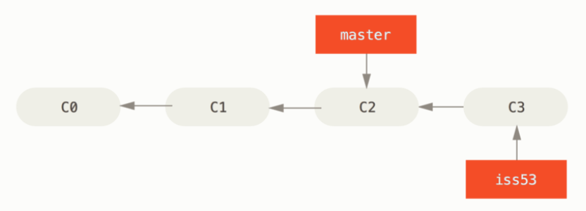
STEP 3

Slide 18
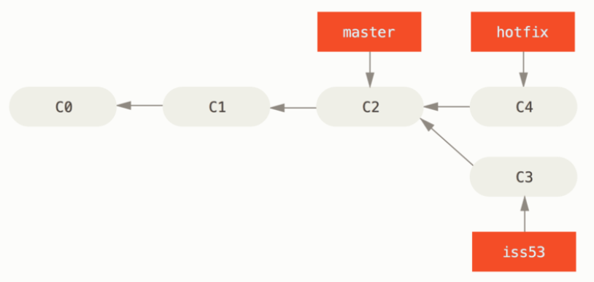
STEP 4

Slide 19
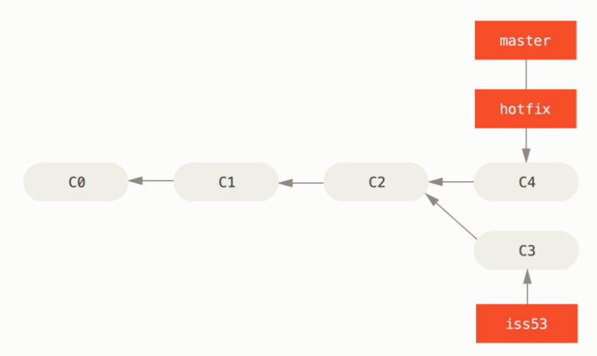
STEP 5

Slide 20
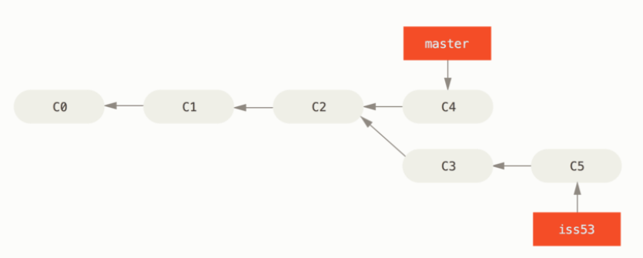
STEP 6

Slide 21
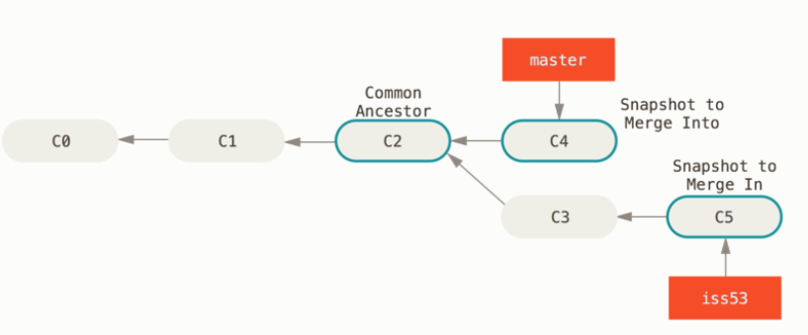
STEP 7

Slide 22
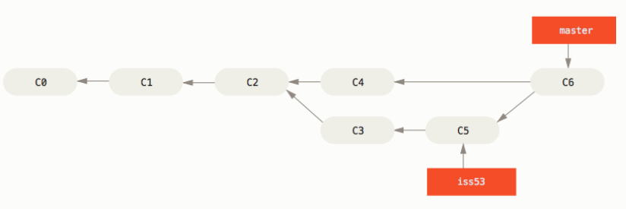
STEP 8

Slide 23
HELP – GIT & BRANCHING AND MERGING
https://git-scm.com/book/en/v2/Git-Branching-Basic-Branching-and-Merging -
https://git-scm.com/book/en/v2

Slide 24
HOME TASK 1
Step 1: Create a new local repository (git) with name “RVRJC_Local_Branchname”. Create multiple files in the local repository and commit.
Step 2: Create a new remote repository (github) with name “RVRJC_Remote_Branchname”. Perform push operation ( only files) from local repository to remote repository.
Step 3: Perform some changes in the remote repository and pull (only files) to the local repository.
Step 4: Perform clone (directory with files) operation to retrieve the entire directory of remote repository to local repository.

Slide 25
HOME TASK 2
PERFORM BRANCHING AND MERGING
Do some work on master branch.
Create a branch feature1 to add a new feature. Do some work in that branch.
Switch to your master branch.
Create a branch feature2 to add a new feature. Do some work in that branch.

Slide 26
HOME TASK 2 Cont..
After work completion, merge the feature1 branch to master.
After work completion, merge the feature2 branch to master.
Solve the conflicts while merging and commit.

Slide 27
GIT Certification at Infosys Springboard
Courses to complete
Git & GitHub: Working with Git Repositories
Git & GitHub: Introduction
by
Kishan Iyer
Software Engineer and Big Data Expert

